Slide 1
Introduction to MATLAB
Week 3 Lecture 6
Polina Cherepanova: cherepanova@princeton.edu
Polina Iamschinina: pi7127@princeton.edu

Slide 2
Topics for today’s class
If statement
While loop
For loop

Slide 3
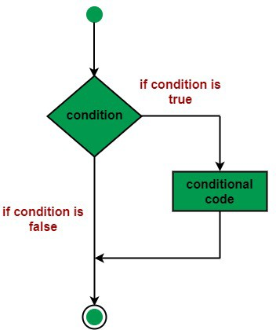
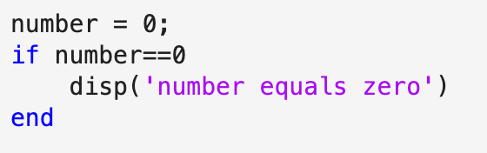
If statement
What would this code output?
What would this code output if number = 4?
Image: https://www.javatpoint.com/matlab-if-end-statement

Slide 4
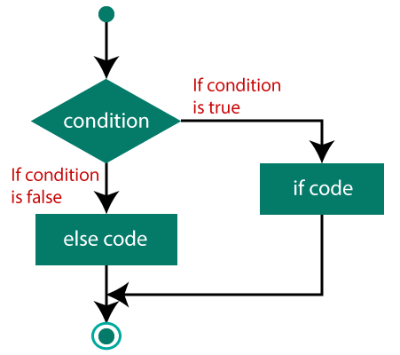
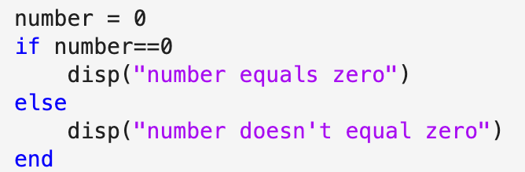
If else statement
What would this code output?
What would this code output if number = 4?
Image: https://www.javatpoint.com/matlab-if-else-end-statement

Slide 5
Exercise 1: Write an if else statement!
Generate a 4-element array of random integers.
Return “The sum is ___ and it is greater than 20” if the
sum of the array is greater than 20
Return “The sum is ___ and it is less than 20” if the sum
of the array is less than 20.

Slide 6
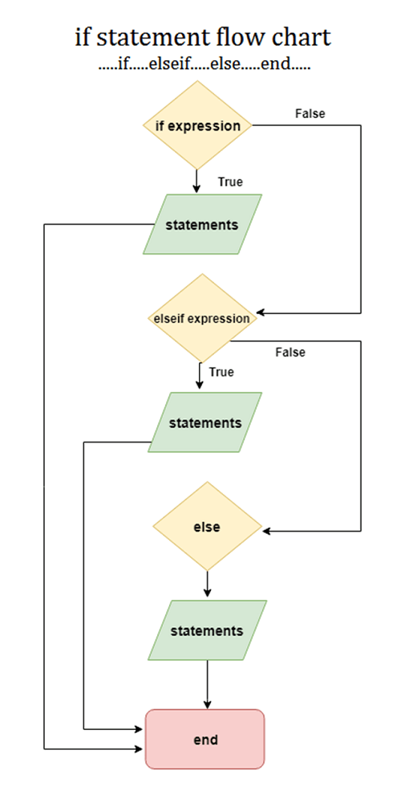
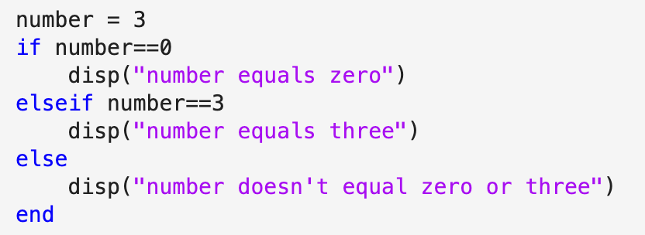
If elseif… else statement
What would this code output?
What would this code output if number = 0?
What would this code output if number = 4?
Image: https://www.javatpoint.com/matlab-if-elseif-else-end-statement

Slide 7
Exercise 2: Write an if elseif statement!
Generate a 4-element array of random integers.
Return “The sum is ___ and it is greater than 20” if the
sum of the array is greater than 20
Return “The sum is 20” if the sum of the array is
equal to 20
Return “The sum is ___ and it is less than 20” if the sum
of the array is less than 20.

Slide 8
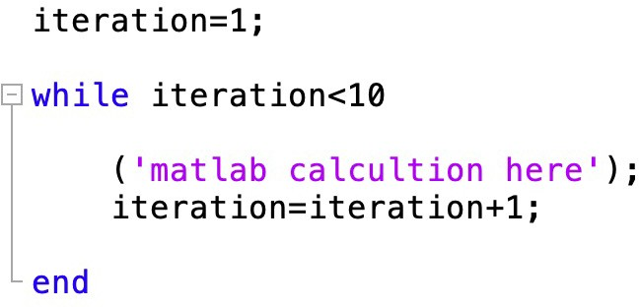
While loop

Slide 9
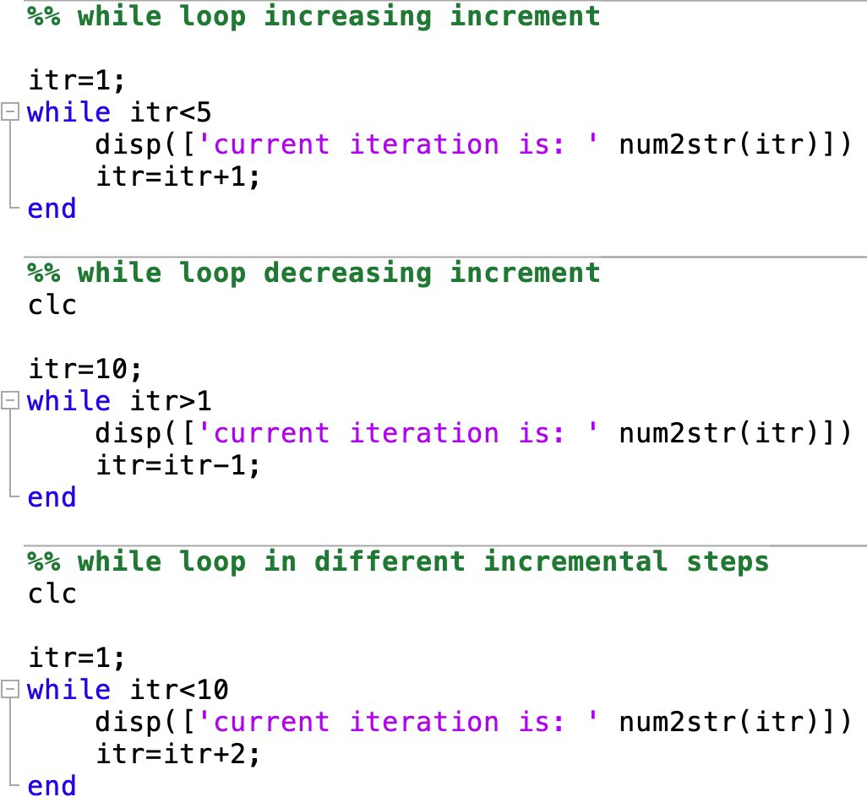
While loop

Slide 10
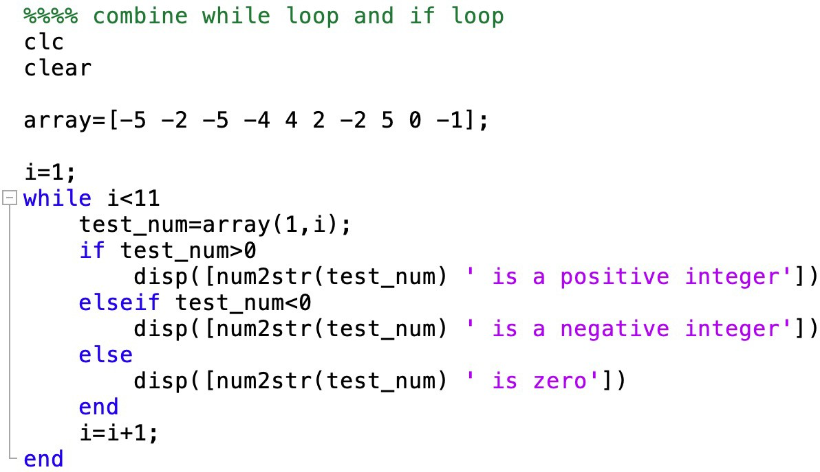
While and if loop

Slide 11
Exercise 3: Write a while loop!
Generate a 5-element array of random integers.
For each element of the array, if the element is greater than 5
or equal to 1, return the element.

Slide 12
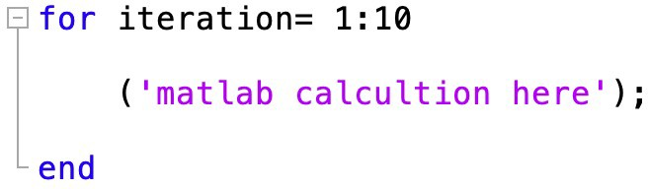
For loop

Slide 13
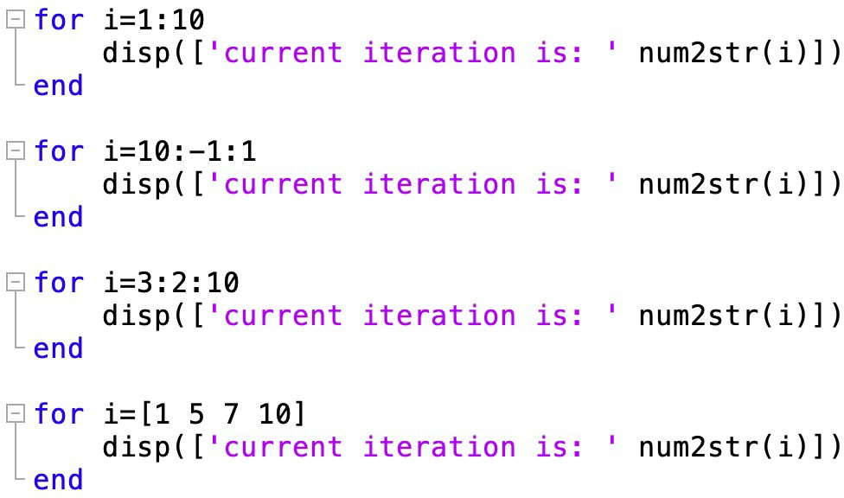
For loop

Slide 14
Exercise 4: Write a for loop!
Solve the problem in Exercise 3 using a for loop instead!
Generate a 5-element array of random integers.
For each element of the array, if the element is greater than 5
or equal to 1, return the element.

Slide 15
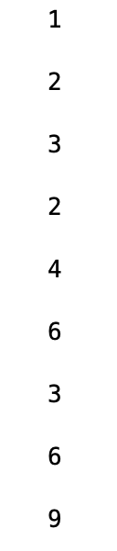
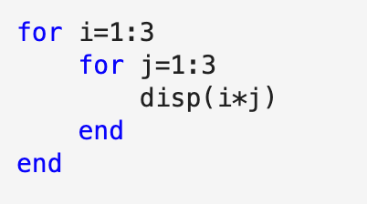
Nesting loops
We can nest if, while and for loops!

Slide 16
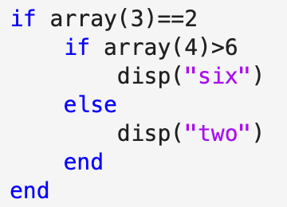
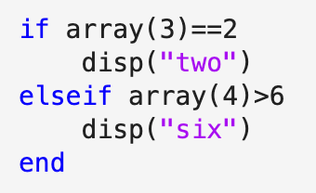
Nesting loops
Is there a difference between these two sections of code?

Slide 17
Exercise 5: Add the elements of two matrices
Generate two random 3x4 matrices consisting of integers
between -6 and 6.
Write a nested for loop that creates a new 3x4 matrix called
`sum_matrix` that contains the sum of the two matrices.

